Slide 1
Strategies for Tracking Work
Notes:
Animations: fly in only

Slide 2
What am I doing?
Notes:
animated

Slide 3
Getting Things Done
Most Important Things (MIT)
Pomodoro Technique
Brain Peaks and Valleys

Slide 4
Boundaries
Stop working at the end of your work day
What are your one-up’s expectations?
Do you need Outlook on your personal device if you’re working from home?
Take your PTO
Interruptions are going to happen

Slide 5
What do I track?
Work on your projects
“Big” tasks
No need to capture every single task
Don’t micromanage yourself
Use common language

Slide 6
Simplest Method
Daily or weekly email list to your one-up
Running list on Excel or Word
Keep an Action List

Slide 7
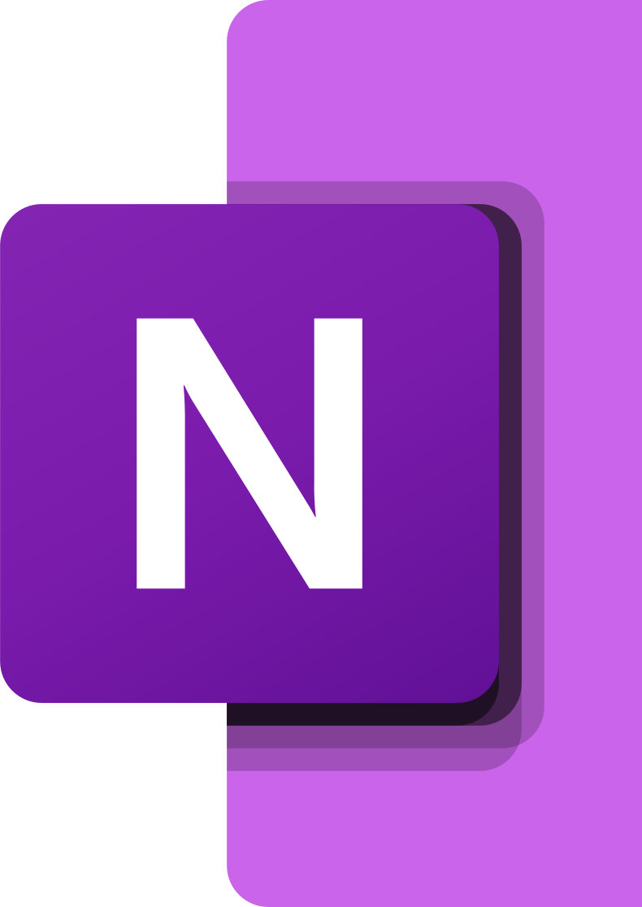
OneNote in Office.com
Create an accomplishment notebook
You can share with your one-up and team
This Photo by Unknown Author is licensed under CC BY-SA

Slide 8
Other Tools
Microsoft Planner
Project management
Assign tasks and track progress
Microsoft Teams
Links to OneNote and Planner
Create a Notes document on Activity
Other tools may be coming soon!

